Slide 1






Cab Price Prediction using Machine Learning
Predicting ride prices based on distance, cab type, time, and location
Submitted By,
Suraj

Slide 2
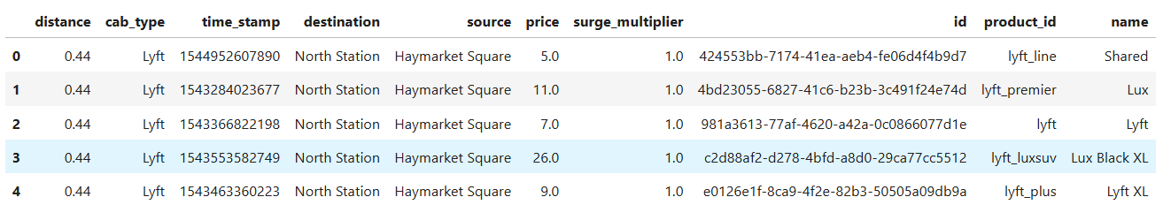

Project Overview
Objective : Predict cab ride prices based on ride features.
Dataset : 693,071 rides with columns like distance, cab_type, source, destination, time_stamp, price, etc.
Target Column : Price
Dataset :

Slide 3
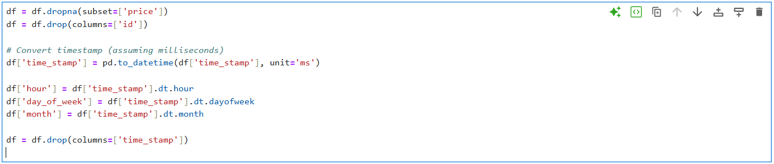
Data Cleaning
Dropped unnecessary columns : id
Removed rows with missing price values
Converted time_stamp to datetime format
Created new features : hour, day_of_week, month
Code Snippet :

Slide 4
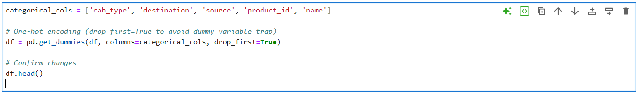
Data Encoding
One-hot encoding applied to categorical columns (cab_type, source, destination, name)
Converted all categorical data into numerical format for ML model
Code Snippet :

Slide 5
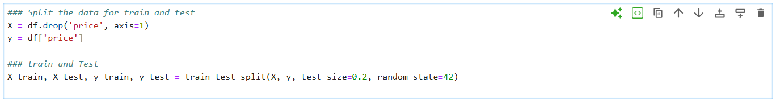
Data Splitting
Full Dataset
Split dataset into training set and testing set
Training set used to train the model
Testing set used to evaluate model performance
Training Set (80%)
Testing Set (20%)
Code Snippet :

Slide 6
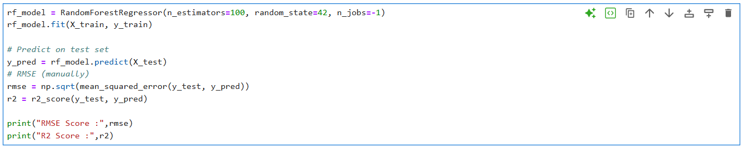
Initial Model & Metrics
Used RandomForestRegressor as the baseline model
Evaluated performance using RMSE and R²
Initial results:
RMSE: 1.79
R²: 0.96
Code Snippet :

Slide 7
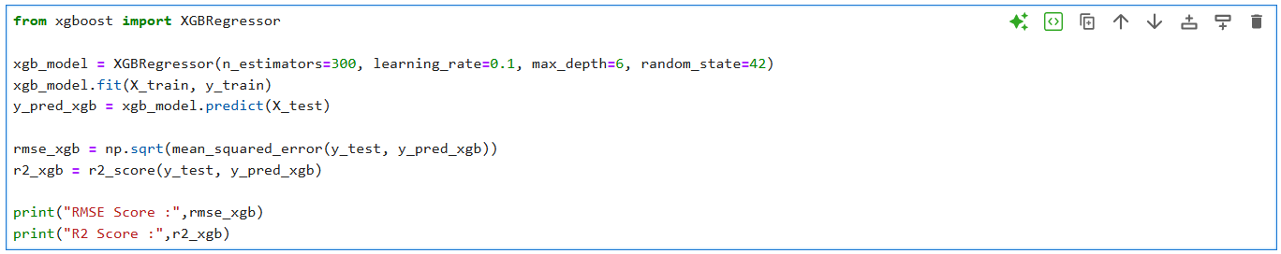
Improved Model: XGBoost
Used XGBRegressor for better performance
Optimized hyperparameters to reduce prediction error
Improved results compared to Random Forest:
RMSE: 1.63
R²: 0.97
Code Snippet :

Slide 8
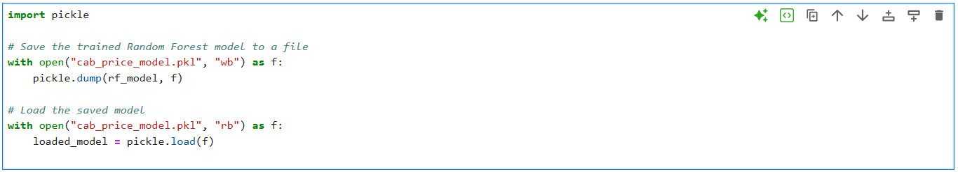
Predicting New Rides
Load the saved model from pickle file
Define a function to predict price for new rides
Input features: distance, cab_type, source, destination, time_stamp, surge_multiplier
Save predicted price to CSV for future use
Code Snippet :

Slide 9
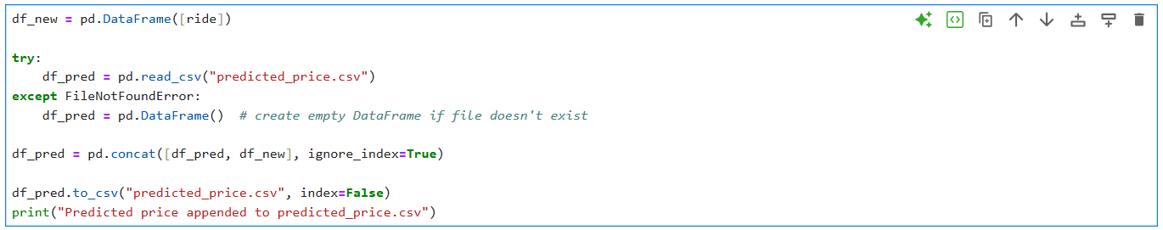
Saving Predictions & Visualization
Predicted prices are saved to CSV for record-keeping
Visualized data for insights:
Cab type distribution
Distance distribution
Price vs distance by cab type
Top 5 ride sources
Code Snippet :

Slide 10
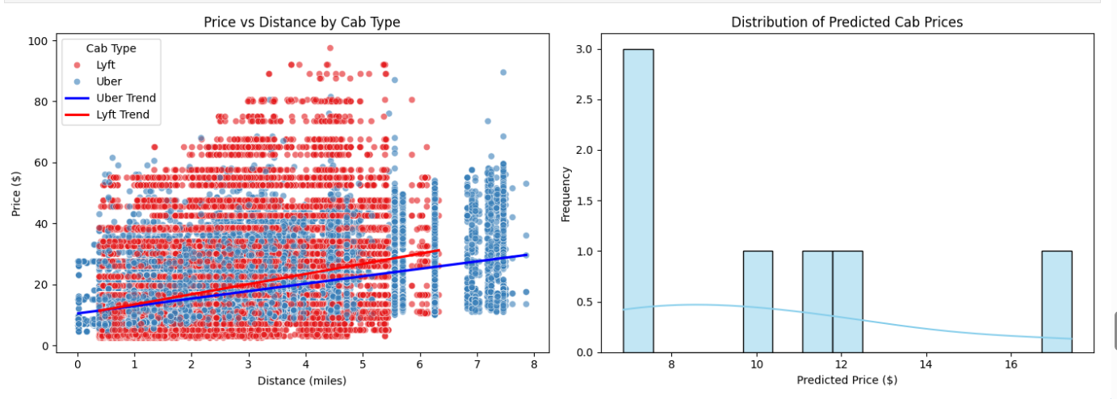
Visualized data for insights
SYSTEM AND SOFTWARE REQUIREMETNS
comparing original dataset vs predicted data

Slide 11
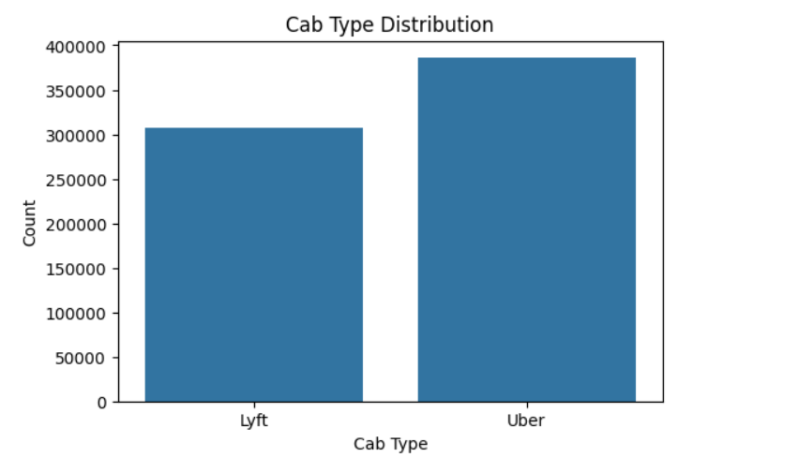
Visualized data for insights
SYSTEM AND SOFTWARE REQUIREMETNS
Cab type distribution

Slide 12
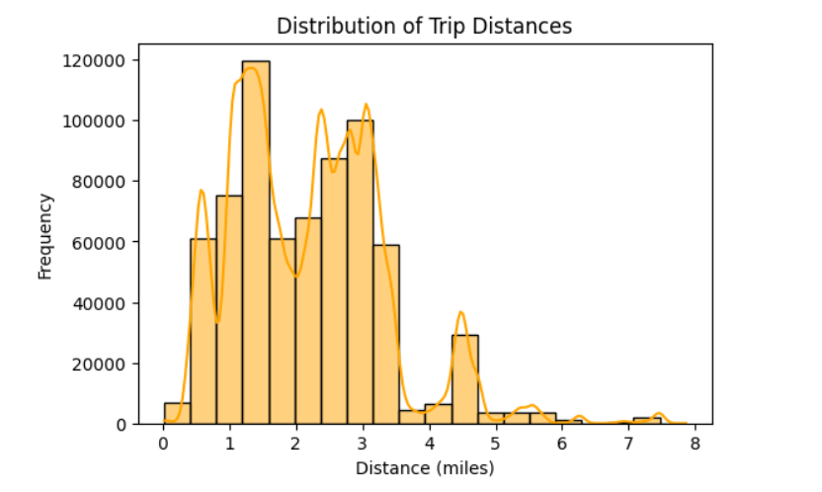
Visualized data for insights
SYSTEM AND SOFTWARE REQUIREMETNS
Distance distribution

Slide 13
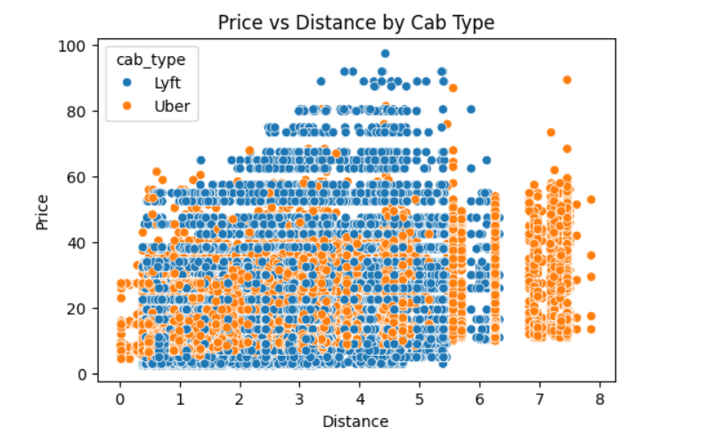
Visualized data for insights
SYSTEM AND SOFTWARE REQUIREMETNS
Price vs distance by cab type

Slide 14
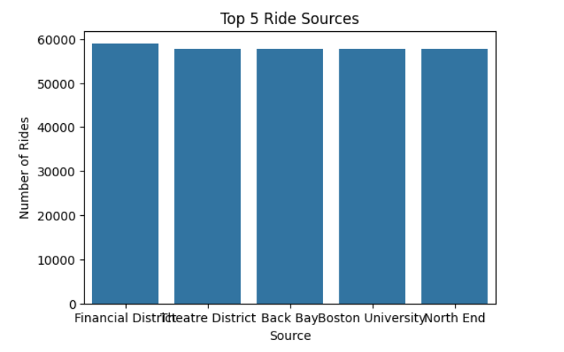
Visualized data for insights
SYSTEM AND SOFTWARE REQUIREMETNS
Top 5 ride Sources

Slide 15
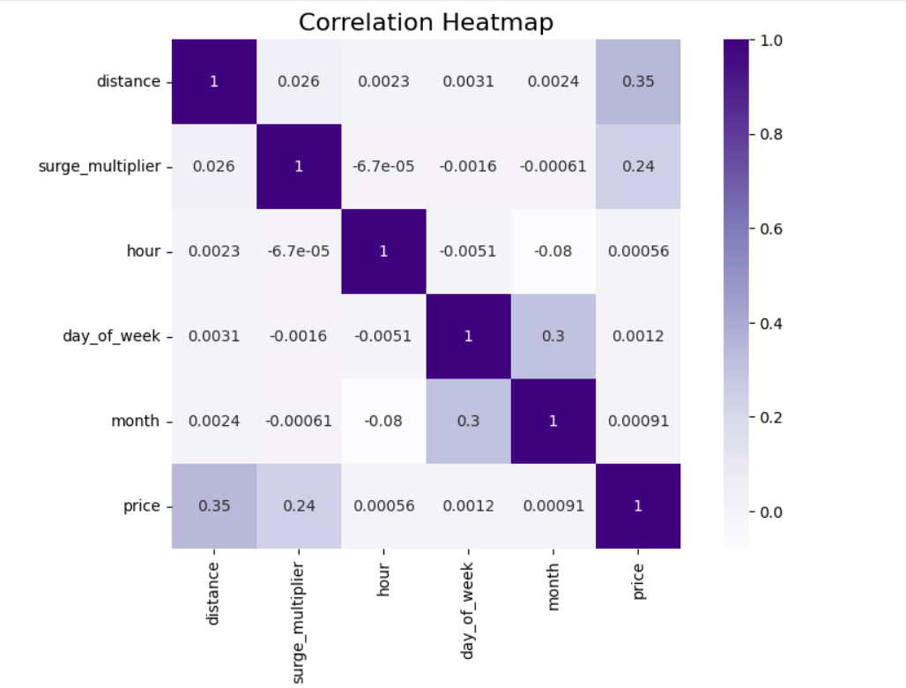
Visualized data for insights
SYSTEM AND SOFTWARE REQUIREMETNS
Correlation Heatmap

Slide 16
Conclusion & Learnings
SYSTEM AND SOFTWARE REQUIREMETNS
The project demonstrates an end-to-end ML workflow for predicting cab ride prices.
Ride-sharing companies can use this model to dynamically price rides based on distance, cab type, time, and surge multiplier.
Customers could benefit from fare estimates before booking a ride.
The model can help optimize fleet management and forecast revenue for ride services.
Data-driven insights from visualizations assist in understanding popular routes, peak hours, and high-demand areas.
This project can be extended to include additional features like weather, traffic, or events for more accurate pricing.

Slide 17
THANK YOU

